Slide 1



Rx
CurVia
SMART PHARMACY MANAGEMENT SYSTEM
Graduation Project Documentation — ServiceNow Platform Implementation
Makrina Emad Petro | Information Technology Institute (ITI) | 2026

Slide 2
Agenda
01
Project Overview & Problem Statement
05
Service Portal & Dashboard
02
System Architecture & Data Model
06
Security & Test Scenarios
03
Core Workflows & Automation
07
Results & Future Enhancements
04
SLA Management & Complaints

Slide 3
01
Project Overview
CurVia Smart Pharmacy Management System — ServiceNow Platform

Slide 4
Problem Statement
📦
Inventory Gaps
🔔
No Alerts
Manual tracking causes stockouts & expired medicines reaching patients
Lack of automated alerts for low stock and expiry dates
📋
Poor Tracking
📧
Manual Notifications
No systematic customer request tracking — poor service quality
Stakeholders notified manually, causing delays & inefficiencies
🚨
No Complaints Hub
⏱️
SLA Blind Spots
Centralized complaint management absent — issues go unresolved
Manual SLA tracking makes enforcement impossible

Slide 5
Project Objectives & Scope
Objectives
Customer
Digitize complete medicine inventory lifecycle from procurement to dispensing
Enable customers to request medicines via self-service portal
Automate approval workflows with multi-stage review
Implement automated low-stock alerts & expiry monitoring
Enforce SLA compliance for all requests and complaints
Provide real-time operational dashboards
Build professional customer-facing Service Portal
Self-register & manage profile
Submit medicine requests
Track request stages
File complaints
Admin
CRUD medicine inventory
Approve/reject requests
Manage complaints & reorders
SLA monitoring & dashboard
Pharmacist
View & update inventory
Complete catalog tasks
Investigate complaints

Slide 6
02
System Architecture
Data Model, Tables, Roles & ServiceNow Components

Slide 7
Application Scope & Technology Stack
Scoped Application Properties
Core ServiceNow Components Used
Application Name
Pharmacy Management System
Flow Designer:
No-code approval & lifecycle automation
Scope Prefix
x_1970979_pharma_0
Service Catalog:
Medicine request submission portal
Version
1.0.0
Business Rules:
Low stock alerts, expiry blocking, auto-assign
Platform
ServiceNow (PDI)
SLA Management:
Request & complaint time tracking
Service Portal:
Patient registration & request tracking
ACLs:
Role-based record & field access control
Script Include:
MedicineAvailability (client callable)
Client Scripts:
Real-time availability & date validation

Slide 8
Data Model — Custom Tables
Pharmacy Medicine
Medicine inventory with status, expiry, pricing, batch & reorder info
Standalone
Customer Profile
Patient profile linked to sys_user account for portal login
Standalone
Customer Complaint
Patient complaints with full lifecycle, SLA tracking & replacement flow
Extends Task
Pharmacy Reorder
Reorder requests triggered by low stock alerts with priority calculation
Extends Task

Slide 9
Roles, Groups & Access Control
pharmacy_admin
pharmacist
pharmacy_customer
Role + Group
Role + Group
Role + Group
Full CRUD on all pharmacy records
Approve / reject medicine requests
Manage complaints & reorders
Dashboard & SLA monitoring
Receives low stock & SLA alerts
Read/Write medicine inventory
Complete catalog tasks
Investigate complaints
Manage reorder tasks
Create own medicine requests
View own records only
Submit complaints
Track requests in portal
User: pharmacy.admin
User: test.pharmacist
User: test.customer

Slide 10
03
Core Workflows & Automation
Medicine Request Lifecycle, Low Stock & Expiry Monitoring

Slide 11
Medicine Request Lifecycle — Flow Designer
New
Under Review
Approved
Ready for Pickup
Completed
→
→
→
→
Customer submits via portal
Admin approval requested
Pharmacist creates task
Stock deducted
Customer confirms delivery
Rejected
Cancelled
Business Rules Supporting the Flow
BR-01
Set Customer Name — auto-links Customer Profile to RITM on insert
BR-04
Stock Deduction — deducts quantity when stage moves to Ready for Pickup
BR-02
Map Catalog Variables — extract medicine name, link to inventory record
BR-05
Stock Restoration — restores quantity on cancellation
BR-03
State Sync — keeps RITM State in sync with Stage for SLA & portal

Slide 12
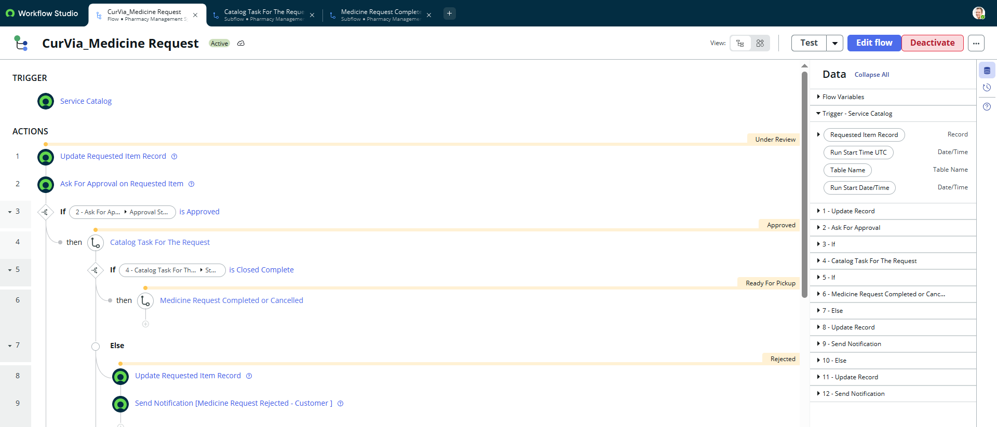

Slide 13
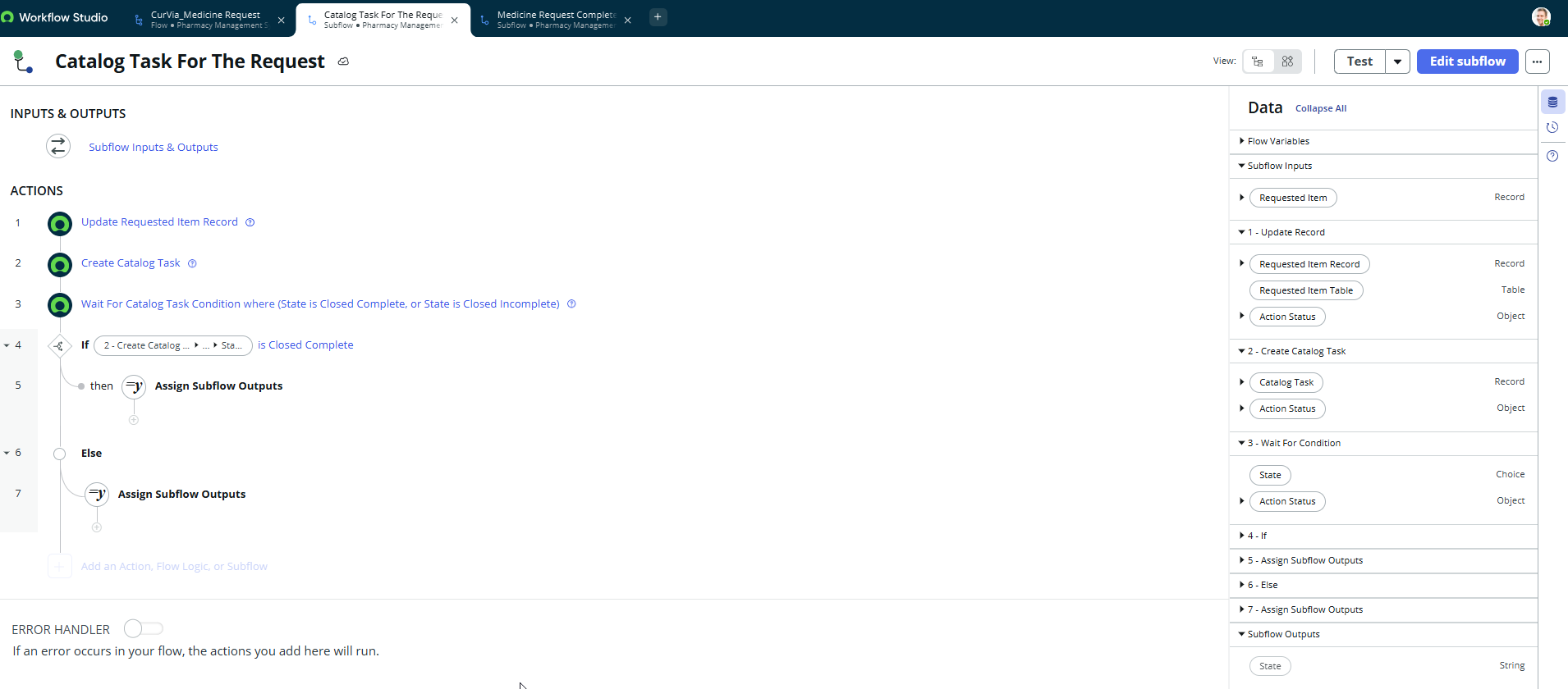

Slide 14
Inventory Automation — Low Stock & Expiry
Low Stock Automation
Expiry Monitoring (Scheduled Job)
0–25%
Priority 1 — Critical
Active
Expiry > 30 days away
26–50%
Priority 2 — High
Near Expiry
Expiry ≤ 30 days (still requestable)
51–75%
Priority 3 — Moderate
76–100%
Priority 4 — Low
Expired
Expiry date passed → Read-only form
BR-01: On quantity change → if qty ≤ reorder level:
Scheduled Job: ExpiryCheck
Fire low_stock event → Send email notification → Create Reorder record with calculated priority
Runs daily at 06:00 UTC • Scans all Active/Near-Expiry medicines • Updates status automatically

Slide 15
04
SLA Management & Complaints
Automated enforcement, complaint lifecycle & replacement flows

Slide 16
SLA Definitions & Notification Pipeline
MedicineRequestSLA
PharmacyComplaintSLA
Duration:
2 Hours
Duration:
2 Hours
Schedule:
8–5 Weekdays
Schedule:
8–5 Weekdays
Table:
sc_req_item (RITM)
Table:
Customer Complaint
Start:
Stage = Under Review
Start:
State = New
Stop:
Stage = Approved OR Rejected
Stop:
State = Closed Completed
Target:
Response
Target:
Resolution
SLA Notification Flow – 2 Flows Created
SLA Timer
Starts
75% Warning
Email Sent
100% Breach
Email Sent
Admin Takes
Action
→
→
→

Slide 17
Complaint Management — Lifecycle & Replacement Flow
Complaint Lifecycle
Replacement Request Logic
1
Customer submits complaint via Record Producer (portal)
Complaint type: Wrong Medicine
Pharmacist approves complaint
BR-10 (Global) fires via Cart API
New RITM created automatically
Replacement flag set = true
Stock NOT deducted again
Estimated delivery: +2 hours
RITM linked back to complaint
2
BR auto-links medicine & customer from referenced RITM
3
N-09 notifies Pharmacy Admin of new complaint
4
Admin assigns to Pharmacist group for investigation
5
Wrong Medicine → Flow asks Pharmacist for approval
6
If Approved: BR-10 auto-creates Replacement RITM via Cart API
7
Customer notified (N-10) with replacement request details
8
Complaint resolved with mandatory Resolution Notes

Slide 18
05
Service Portal & Dashboard
Patient-facing portal, real-time KPIs & operational reports

Slide 19
Service Portal — Patient Experience
Home Page
Login Page
🏠
🔐
Welcome widget with animated background, Request Medicine & Report Problem buttons. Personalized greeting for logged-in users.
Branded CurVia login with 'Create account' link directing new patients to self-registration.
Registration Form
Medicine Request
📝
💊
Self-registration via Record Producer: name, email, phone, gender, address. Automatically creates sys_user + Customer Profile.
Catalog form with real-time availability checker, price auto-fill, and 1-hour minimum pickup date validation.
Request Tracker
My Requests
📍
📋
Stage-by-stage visual tracker (New → Under Review → Approved → Ready → Completed) with timestamps.
Filterable list of all personal requests with state and last-updated info.
My Approvals
My Reports
✅
📊
Delivery confirmation screen — customer approves/rejects pickup with medicine name and preferred date.
Complaint history showing complaint number, medicine, type, and resolution state.

Slide 20
Dashboard & Notification System
KPI Dashboard Widgets
Notifications (12 Total)
N-01
Low Stock Alert → Admin
N-07
Request Rejected → Customer
3
1
1
2
N-02
Medicine Request SLA 75% → Admin
N-08
Request Cancelled → Admin
Active Medicines
Near Expiry
Expired
Low Stock
N-03
Medicine Request SLA Breach → Admin
N-09
New Complaint Alert → Admin
Operational Reports
N-04
Complaint SLA 75% Warning → Admin
N-10
Complaint Approved (Replacement) → Customer
Pie Chart
Inventory by Status:
Active / Near Expiry / Expired split for instant inventory health check
N-05
Complaint SLA Breach → Admin
N-11
Complaint Rejected → Customer
Bar Chart
Requests by Stage:
N-06
Medicine Ready for Pickup → Customer
N-12
New Complaint Created → Admin
Pipeline visibility — spot approval bottlenecks instantly
Bar Chart
Top Medicines Requested:
Demand insights to guide procurement & reorder level adjustments

Slide 21
06
Security & Test Scenarios
ACL architecture, role-based access, and verified use cases

Slide 22
ACL Security Architecture — 36 Rules
Table
Create
Read
Write
Delete
Pharmacy Medicine
pharmacist, admin
pharmacist, admin, customer (limited)
pharmacist, admin
admin only
Customer Profile
customer (self-reg), admin
customer (own record), admin
customer (own), admin
admin only
Customer Complaint
customer, admin
customer (own), admin, pharmacist
admin, pharmacist
admin only
Pharmacy Reorder
auto (BR), admin
admin
admin
admin only
MedicineAvailability Script Include: execute access for all authenticated users

Slide 23
Key Test Scenarios — Verified Cases
S-01
Happy Path Request
Request
S-02
Request Rejected
Request
Stock deducted, all notifications sent, RITM = Closed Complete
Customer notified, stock NOT deducted, state = Closed Incomplete
S-03
Customer Cancels
Request
S-04
Expired Medicine Approval
Inventory
Stock restored only if stage was Ready for Pickup
Error: 'Cannot approve expired medicine request.'
S-05
Replacement Request Flow
Complaint
S-06
Low Stock Warning
Portal
Replacement RITM auto-created, stock NOT deducted again, 2-hr delivery
Yellow warning in portal: 'Low Stock, only N units left'
S-7
Low Stock Detection
Inventory
S-8
Expired → Read-Only
Inventory
Admin email sent, reorder record created with calculated priority
All form fields become read-only via UI Policy on expired status
S-9
Customer Self-Registration
Portal
S-10
SLA Warning (75%)
SLA
sys_user created, pharmacy_customer role assigned, profile linked
Warning email sent to admin with request details & time remaining

Slide 24
07
Results & Future Work
Implementation summary, lessons learned & enhancement roadmap

Slide 25
Implementation Summary — What Was Built
9
2
6
12
2
36
Business Rules
(Active)
Global
Business Rules
Flows
(Main + Sub)
Email
Notifications
SLA
Definitions
ACL
Rules
All Core Requirements Implemented ✓
✓
Complete medicine inventory with auto-numbering & status tracking
✓
SLA enforcement with 75% warning and 100% breach notifications
✓
Customer self-registration with automatic role assignment
✓
Complaint lifecycle with mandatory resolution notes
✓
Full approval workflow from request submission to delivery confirmation
✓
Professional Service Portal with CurVia branding
✓
Automated low stock detection and email notification pipeline
✓
Role-based access control at record & field level
✓
Daily expiry monitoring with automatic status classification
✓
Real-time dashboard with inventory KPIs & request analytics

Slide 26
Future Enhancements & Roadmap
AI Medicine Recommendations
Supplier API Integration
🤖
🔗
Now Intelligence / ML models for personalized medicine suggestions based on patient history
Direct integration with external supplier APIs for automated reorder placement and tracking
Batch Handling
Prescription OCR
📱
📷
Handle new batches with quntity and, expiration date, and FIFO Concept For Requests
Prescription image upload with OCR processing for automatic medicine name extraction
Predictive Low Stock
Multi-Pharmacy Support
📈
🏥
ML-based alerts using historical consumption patterns to predict stockouts before they happen
Inventory sharing and transfer workflows across pharmacy chain locations
WhatsApp / SMS Alerts
Financial Reporting
💬
💰
Twilio REST API integration for multi-channel patient notifications
Revenue tracking, cost analysis, and insurance provider prescription verification module

Slide 27
Rx
CurVia
SMART PHARMACY MANAGEMENT SYSTEM
Thank You
ITI Graduation Project 2026 • Built on ServiceNow Platform
Prepared by: Makrina Emad Petro

